Slide 1
Recognition and Detection of Letters in Images
Kristina Pomorišac
Software engineering and information technology
Faculty of Technical Science, Novi Sad

Slide 2
Introduction
Recognition of letters in images is done by using Optical character recognition also known as OCR. Which is the mechanical or electronic conversion of images of typed, handwritten or printed text into machine-encoded text, whether from a scanned document, a photo of a document or from subtitle text superimposed on an image. It is widely used as a form of information entry from printed paper data records. It is a common method of digitalizing printed texts so that they can be electronically edited, searched, stored more compactly, displayed on-line, and used in machine processes such as cognitive computing, machine translation, text-to-speech, key data and text mining.

Slide 3
How It Works
1. Image Processing and Object Detection
After having loaded the image, it needs to be preprocessed by doing the step below:
Increasing Contrast: this is done by maximizing the contrast between two classes of pixels, separated by the threshold and increasing the intensity or color in the image itself.
After image cleaning, object detection is performed. Contours are identified and a rectangle is drawn around objects candidates. The result of this process is the following figure.

Slide 4
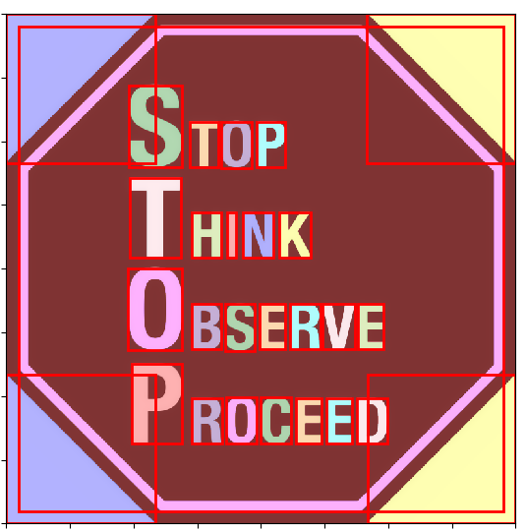
As you can see a lot of rectangles have been identified. Not all of them contain text.
After this the objects are converted to grayscale, resized to 20 X 20 pixels and then stacked into a threshold (numpy array).
The coordinates of each rectangle are also saved in order to be able to reconstruct the image afterwards.
As shown in the image bellow:

Slide 5
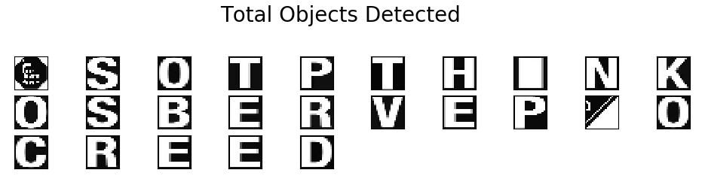

Slide 6
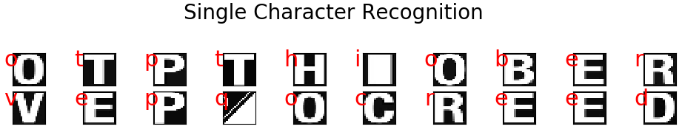
2. Letter Detection and Classification
Here we identify objects contain text in order to be able to classify it. We train a model that uses a proper dataset, consisting ideally of half images containing text and half not containing it.
The complete dataset was then composed of 100k images, properly labeled and randomly shuffled. This is done by using 2 steps:
Histogram Of Gradient (HOG): used to recognize shapes of objects using the difference between pixels ands colors;
LinearSVC: used to classify the letters;
Which gives us the following result:

Slide 7
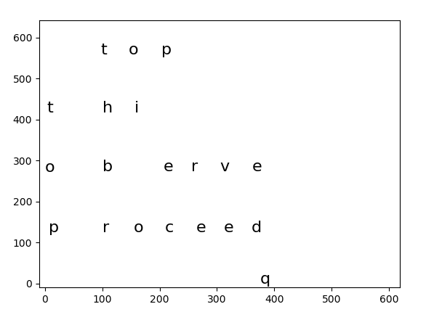
3. Text Reconstruction
Here we put together all the Objects with letters detected in it.
By placing them in the position they would originally be in the uploaded image.

Slide 8
Conclusion
Noticeably the program is not running perfectly. Sometimes it does not recognize objects that contain letters due to bad contour recognition when the objects are too close to each other or have contrast issues with the background, by having too similar colors making it difficult to separate the pixels. Also, different Font types make it more difficult to distinguish and detect letters.
Nevertheless, the program works in the right path to achieve it’s final result: to detect and recognize the letters within given pictures or images.

